Slide 1
Depth First Search/Topological Ordering

Slide 2
Algorithm to Understand DFS
Step 1 – initialize all the nodes to ready state.
Step 2 – push starting node on stack and repeat until the branch is empty.
Step 3- pop the top node and change the state to processed.
Step 4 – push all the nodes that are in ready state.
Step 5- exit

Slide 3
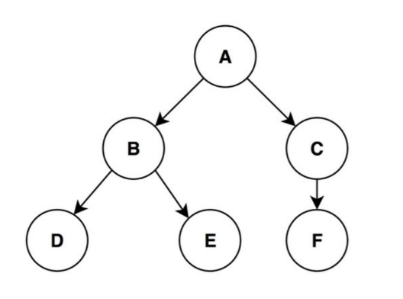
Example

Slide 4
Example answer
DFS of the above mentioned example will be:
ADEBFC

Slide 5
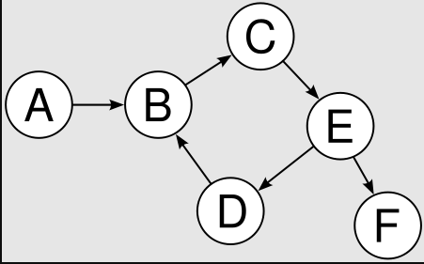
Another example

Slide 6
Solution
The DFS of the above mentioned example will be:
AFDBEC

Slide 7
Topological Ordering
The topological sort algorithm takes a directed graph and returns an array of the nodes where each node appears before all the nodes it points to.
The ordering of the nodes in the array is called a topological ordering.
Let us understand it with the help of an example.

Slide 8
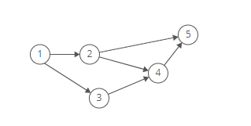
Topological Ordering example

Slide 9
Solution to above problem
As in the above mentioned problem node 1 points to nodes 2 and 3, node 1 appears before them in the ordering. And, since nodes 2 and 3 both point to node 4, they appear before it in the ordering.
So the final look of an array as topological order will be as:

Slide 10
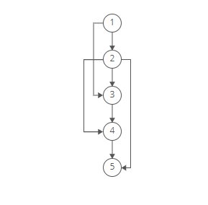
Solution
So [1, 2, 3, 4, 5] would be a topological ordering of the graph.

